Slide 1
Agile Development Tutorial Group 2 Role: Manufacturer

Slide 2
Group members
Chan Chi Lap Toby 54777615
Kwok Ching Yin Mark 54777770
Lo Ho Tin Jeffrey 54777719
Wong Yan Tin Ivan 54777688
Wong Kwun Hoi 54787805

Slide 3
Data interface layout data dictionary

Slide 4
Manufacturers to Logistics
order_no | Char(10)
retailer_id | Char(10)
logistics_id | Char(10)
Ship_date | datetime()
weight | Double(7,5)

Slide 5
Retailers to Manufacturers
item_no | char(10)
qty | int(10)
price_per_item | double(7.2)
retailer_id | char(10)
expected_shipment_date | datetime()
manufacturer_id | char(10)

Slide 6
Responsibilities between Manufacturer & Logistics
Provide order number to the logistics company
Calculate the total weight of the products
Provide ship date to the logistics company
Provide retail ID to determine the retail locations
Provide logistics ID to determine different logistics company

Slide 7
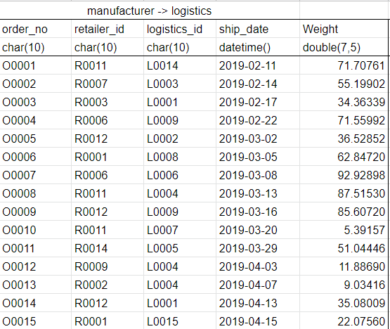

Manufacturer to Logistics Sample Data

Slide 8
Responsibilities between Retailer to Manufacturer
Receiving order from retailer
Assemble the products
Manufacture the products before the retailers expected date

Slide 9

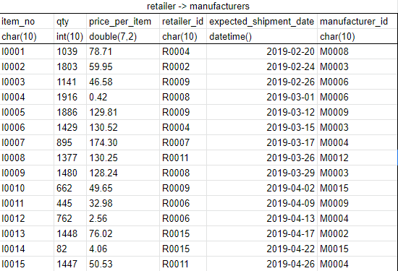

Retailer to Manufacturer Sample Data

Slide 10
End of Presentation

